Slide 1
Python standard Library
Life Choices Coding Academy 2020

Slide 2
Learning outcome:
By the end of this section, student should be able to:
Know where they can find Python Standard Library.
Make use of some of the Python Standard Library modules.

Slide 3
Python Built-in modules
Provide commonly used functionality.
They are loaded automatically and always available.
Contain resources for certain specific functionalities.
More information on the python website.

Slide 4
Date and time: datetime
Supplies classes/functions for manipulating dates/Time
Key classes: Date, Time, Datetime, Timedelta, tzinfo
Notes:
Because they are the most commonly used.
Tzinfo - Is for timezones.

Slide 5
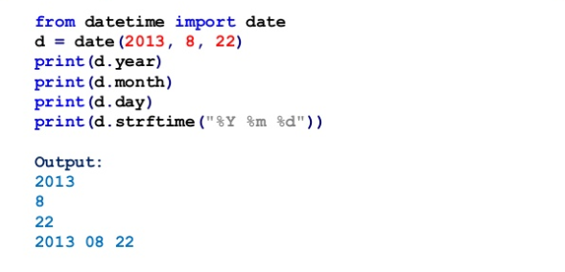
Date objects
Notes:
You can also use dir(date) to see more details regarding the module.

Slide 6
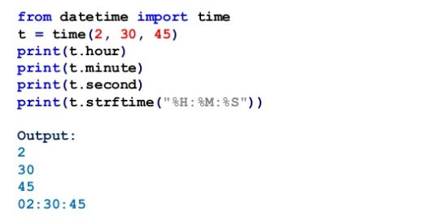
Time objects

Slide 7
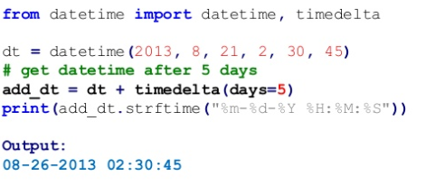
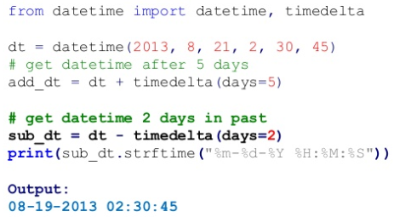
Manipulating dates
Notes:
Also you can demonstrate timedelta in class.
Notice date in the past using a minus.

Slide 8
Exercise time :)

Slide 9
Exercise 1
Print ten dates, each two week apart, starting from today, in the form YYYY-MM-DD
Notes:
import datetime
today = datetime.datetime.today()
for w in range(10):
day = today + datetime.timedelta(weeks=w)
print(day.strftime("%Y-%m-%d"))

Slide 10
Mathematical functions: math
Collection of mathematical functions.
Examples: pi, e, floor, log, sqrt, sin, cos:
Notes:
Demonstrate usage in class

Slide 11
More available on Python Website :)

